Slide 1

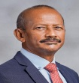
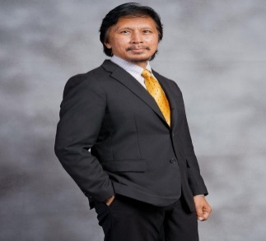
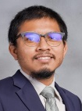

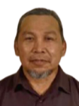
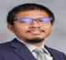
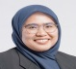
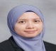
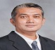
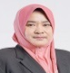
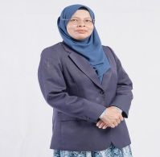
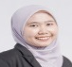






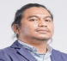






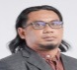


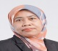



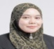


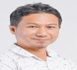



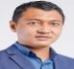
MANAGING DIRECTOR
DATO’ Ir. MOHD ZAKI BIN YUSOF
DIRECTOR
CHIEF OPERATING OFFICER
DIRECTOR (MECHANICAL)
DIRECTOR (ELECTRICAL)
DATO’ Ir. IDRUS BIN AHMAD
Ir. MOHD IRDZWAN BIN MOHD SAHANDRI GANI
Ir. ABU BAKAR BIN MD SIDEK
Ir. SHAMSUDIN BIN MOHAMAD
CIVIL & STRUCTURAL (C&S)
MECHANICAL & ELECTRICAL (M&E)
GIS
CORPORATE SERVICES
STRUCTURAL & DEVELOPMENT
INSFRASTRUCTURE & DEVELOPMENT
HEAD OF M&E
HEAD OF GIS
HEAD OF CORPORATE SERVICES
Ir. MOHD IRDZWAN BIN MOHD SAHANDRI GANI
NOOR AIN BINTI ABDUL MANAN
NADIAH BINTI MOHD ZAKI
DIVISION DIRECTOR
DIVISION DIRECTOR
TECHNICAL DIRECTOR
GIS ASSISTANT
Ir. AFFANDI BIN AHMAD
Ir. NOR LINDA @ MARIATUL KABTIAH BINTI MOHAMAD
IARNIZA BINTI BAKHTIAR
MECHANICAL
HUMAN RESOURCE (HR)
ACCOUNT
NUR LAILA BINTI LATIB
HR EXECUTIVE
DIVISION DIRECTOR
ENGINEERS
ENGINEERS
ENGINEER (GEOTECHNICAL)
ENGINEER
NORISH ADIBA BINTI AZALI
DATIN SHAHRUL BARIYAH BINTI AB RAZAK
PUTERI JUIETA SALWANNI BINTI MD YUSOF
FARIDAH HANOM BINTI ABDUL LATIF
Ir. MOHAMED NAZRIN BIN MD NAZIR
GIS ASSISTANT / SIITE SUPERVISOR
MUHAMMAD FARIS AIMAN BIN MUHAMMAD SANUSI
HANAFI BIN IBRAHIM
INFORMATION TECHNOLOGY (IT)
ACCOUNT EXECUTIVE
WAN NUR FARHANA AZZAHRAH BINTI MEOR MOHD NUR EFFENDI
NORSHAZANANI BINTI SHAFIE
AHMAD ZAHIRULHAQ BIN KHAIRUDDIN
IT OFFICER
HUSNA BINTI MOHD ZAKI
ENGINEER
MOH NASIR BIN JAMALUDIN
MARDIANA BINTI MARZUKI
ACCOUNT EXECUTIVE
DRAUGHTSPERSON
ADMINISTRATION
NURUL KHALISAH BINTI ARIFFIN SHAH
QUANTITY SURVEY
MOHAMAD RIDUAN BIN RAZALI
IMAN KHAIRIAH BINTI MOHD SHAMSUL
ELECTRICAL
ADMINISTRATIVE ASSISTANT
QUANTITY SURVEYOR
MUHAMAD AMIRUL ARASH BIN ZAABA
ENGINEER
IDAKHAIRANI BINTI ROSLAN
ACCOUNT ASSISTANT
BALQIS HANIM BINTI ZULKIFLI
TXUAN CHU TING XUAN
MOHAMAD IZANI BIN MOHAMAD AZMI
NORULSHIDA BINTI HUSSAN
ADMINISTRATIVE ASSISTANT
CUM DESPATCH
SITI NUR HASYIMAH BINTI ZULKIFLI
SYED MOHD ZARUL AZMIN BIN SYED ROSLAN
MOHD ZULRAIDI BIN ZAINUDDIN
NUR ZAIRIN ADRIANA BINTI ZEFFRI
NOR AZLEEN BINTI ARAFIN
TRANSPORTATION
DRIVER / LOGISTIC OFFICER
PUTERA HAZRINSHAH BIN MOHAMMAD SUKRI
MOHD LISHAZWAN BIN ROSSELI

